Slide 1
Linear Regression
10/13/19

Slide 2
What is Supervised Learning?
Teach the model using training data that is already is already labeled with the correct output
Training data has a ground truth
Regression
Used to model a target value based on independent predictors
Most regression techniques will differ based on the number of predictors/relationship between the explanatory and response variables

Slide 3
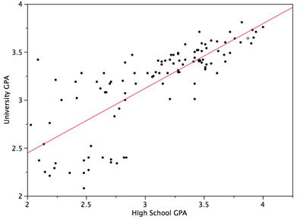
Linear Regression
y = b + wx
Finding the best line to fit two attributes so that one attribute can be used to predict the other
Multivariate linear regression uses a vector
of features instead of one x value
Correlation is not causation => errors in predictions

Slide 4
Some Probability and Statistics

Slide 5
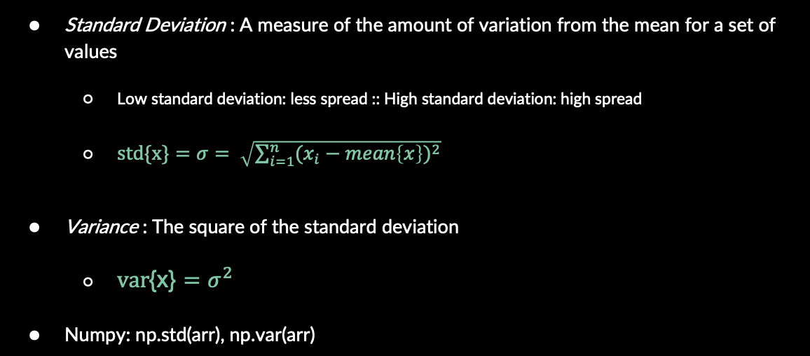
Standard Deviation and Variance
Standard Deviation : A measure of the amount of variation from the mean for a set of values
Low standard deviation: less spread :: High standard deviation: high spread
$\text{s}\text{td}\text{\{}\text{x}\text{\}}=σ= \sqrt{\sum_{i=1}^{n}{{(x_{i}−mean\left\{x\right\})}^{2}}}$
Variance : The square of the standard deviation
$\text{v}\text{ar}\text{\{}\text{x}\text{\}}=σ^{2}$
Numpy: np.std(arr), np.var(arr)
SD for a Normal Curve

Slide 6

Covariance
A measure of the joint variability of 2 variables (variance measured one)
$\text{cov}\text{\{}\text{x}\text{, }\text{y}\text{\}} = \frac{1}{n}\sum_{i=1}^{n}{(x_{i}−mean\left\{x\right\})(y_{i}−mean\left\{y\right\})}$
Covariance of a variable with itself is equal to the variance of that variable
$\text{cov}\text{\{}\text{x}\text{, }\text{x}\text{\}} = \frac{1}{n}\sum_{i=1}^{n}{\left(x_{i}−mean\left\{x\right\}\right)\left(x_{i}−mean\left\{x\right\}\right)}=var\{x\}$

Slide 7

Correlation Coefficient
A measure of the relation between the dependence of 2 variables on each other
A means of quantifying what we expect to happen to one variable as we choose values for the other
Values range between -1 and 1 (inclusive)
Value near -1 indicates strong inverse correlation
Value near 0 indicates no correlation
Value near 1 indicates strong direct correlation
$corr\left\{x,y\right\}=r_{x,y}=\frac{cov\{x,y\}}{std\left\{x\right\}std\{y\}}$

Slide 8
Simple Linear Regression

Slide 9
Simple Linear Regression
When the predicted value y only depends on a single variable x
Think a line in the 2d plane (this is what you are familiar with)
Pros: When we restrict ourselves to this simple case, we can simplify the problem into basic statistics that we know and can reason about
Cons: In the real world, most outcomes have more than one factor so this is not very accurate

Slide 10

Bringing it all Together
Prediction equation: $y= \hat{β}x+\hat{α}$
Slope: $\hat{β}=r_{x,y}\frac{σ_{y}}{σ_{x}}=\frac{cov\{x,y\}}{var\{x\}}$
Y-intercept: $\hat{α}=mean\left\{y\right\}− \hat{β}mean\left\{x\right\}= \overline{y}−\hat{β}\overline{x}$
We can use Numpy to compute these fast!

Slide 11
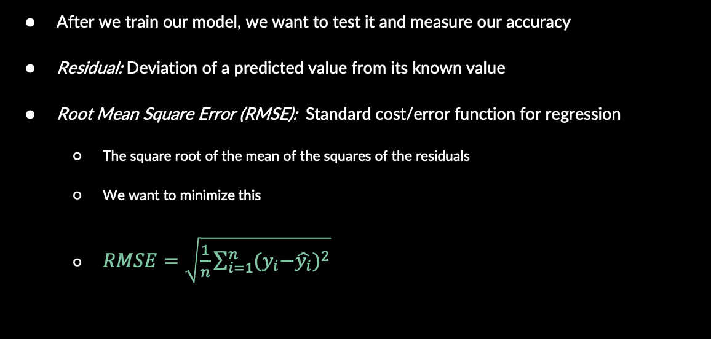
Error Calculation
After we train our model, we want to test it and measure our accuracy
Residual: Deviation of a predicted value from its known value
Root Mean Square Error (RMSE): Standard cost/error function for regression
The square root of the mean of the squares of the residuals
We want to minimize this
$RMSE=\sqrt{\frac{1}{n}\sum_{i=1}^{n}{{{(y}_{i}−\hat{y_{i}})}^{2}}}$

Slide 12

Evaluation Metrics
There are a lot of them, take a statistics class!
$R^{2}=1−\frac{{RMSE}^{2}}{var\left\{y\right\}}=1−\frac{MSE}{var\{y\}}$
Closer to 1: Model explains the variance in our data well (good**)
Closer to 0: Model does not explain the variance in our data (bad**)
There are flaws to this statistic and we should use a variety of methods when evaluating the performance of our model

Slide 13
Multivariate Linear Regression

Slide 14
Multivariate Linear Regression
Numerous variables attribute towards prediction (x is now a vector)
A more general approach that works for any number of variables
We cannot reuse the same basic techniques from simple linear regression and have to take a new approach
There are matrix equations that solve this, however they can be computationally heavy and not always possible to compute
We will use stochastic gradient descent as an approximation technique to speed up the training of our model

Slide 15
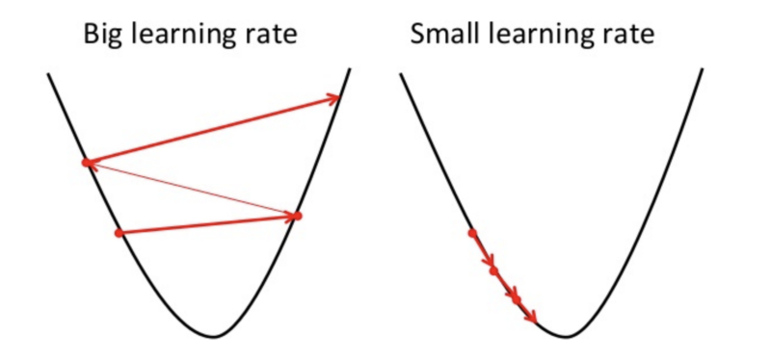
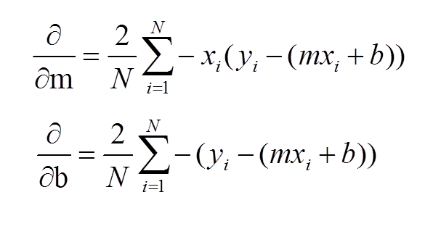
Gradient Descent
Optimization technique
Iteratively updates b and w to reduce the MSE
Taking the gradient of a point acts like a compass and points to the local minimum for a fixed number of steps/until an error threshold is met
Learning rate = how large of a step we take downhill

Slide 16
Assumptions
Data that has:
Linearity between the variables - check with a scatter plot
Constant variance of residuals - no patterns in the residual plots
Normality - the residuals follow a normal distribution and aren’t skewed
Independence - if the predictors are highly correlated they can weaken the prediction power of the model

Slide 17
Limitations
Computationally intensive for high dimensional data
Outliers can affect the prediction strength significantly

Slide 18
Example
Consider predicting the university gpa of students, based on their high school gpa
University GPA = 0.675x + 1.097
If X is 3.1
University Gpa = 0.675*(3.1) + 1.097
= 3.19

